Slide 3
field
electromagnetism

Slide 4
Do you think it is possible to lift something without touching it?
Record your thoughts in your notebook.
Watch the teacher demonstration.

Slide 5
Examples of forces
Contact vs. Noncontact forces

Slide 6
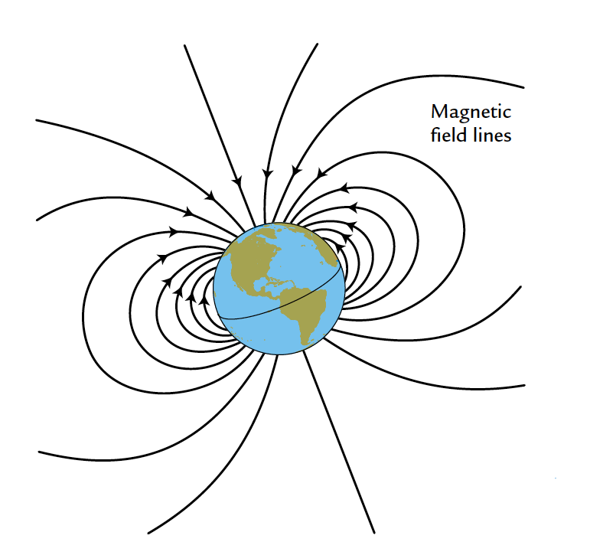
Read the introduction and look for key ideas

Slide 7
What are the properties of magnetic fields?

Slide 8
View the tasting cup with bar magnet
What do you think will happen when the tasting cup is floated inside a cup of water?
Share your thoughts with the class.

Slide 9
Complete procedure part A: Investigating Magnetic Fields
After you have complete Part A, complete the reading in Part B.

Slide 10
Analysis question 1
What made the floating magnet move in Procedure Step 4?

Slide 11
Analysis question 2
What is a compass needle? Explain by using evidence from this activity.

Slide 12
Analysis question 3
State which kind of field causes the effect described in each of the following situations. Give reasons for your answers.
a. An anchor sinks to the bottom of a lake.
b. Your hair sticks to a comb.
c. Two paper clips attract each other.

Slide 13
Analysis question 4
Describe the energy transformations in each of the following situations. Give reasons for your answers.
a. A hot-air balloon takes passengers on a ride.
b. An electromagnet is used to move a car to the top of a pile of junk.

Slide 14
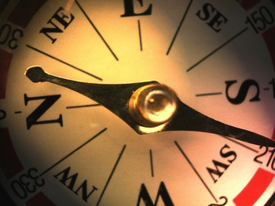
What are the properties of magnetic fields?

Slide 15
Key vocabulary definitions
Field - A way of describing how two objects can interact with one another without touching.
Electromagnetism - Magnetism associated with moving electrical charges.

