Slide 1
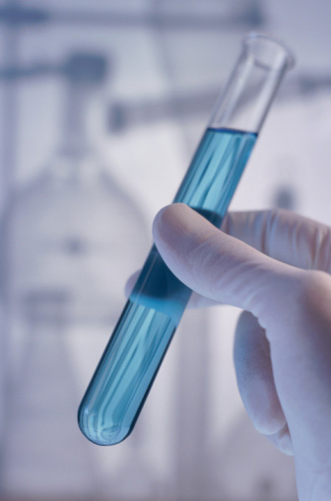
Chemical and physical properties

Slide 2
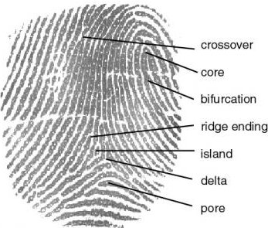
Matter
Every element/compound is unique in some way from all others.
If you know enough about a substance, you can figure out what it is.
If you know what a substance is, you can know all types of things about it.

Slide 3
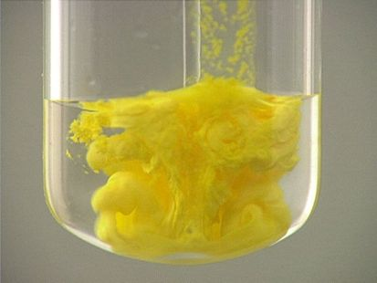
Matter
All matter has 2 types of properties: Physical properties and chemical properties.

Slide 4
Physical properties
A physical property is a characteristic of a substance that can be observed without changing the substance into another substance.
(You can see it without changing what you’re looking at into something else.)

Slide 5
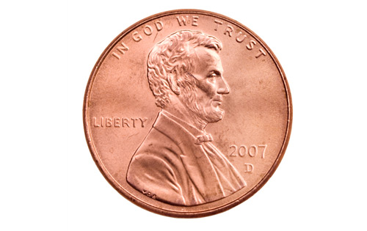
Physical Properties
Physical properties can be extensive or intensive:
Extensive properties depend on the amount of a substance that you have.
Intensive properties don’t depend on how much you have.

Slide 6
Physical Properties - Examples
Examples of extensive physical properties include:
Volume
Mass
Weight
Size

Slide 7
Physical Properties - Examples
Examples of intensive physical properties include:
Density
Melting point
Boiling point

Slide 8
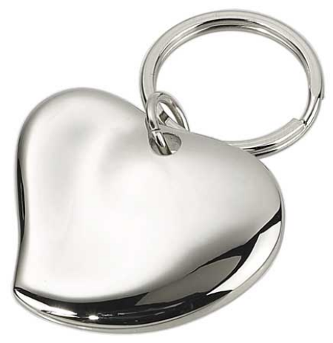
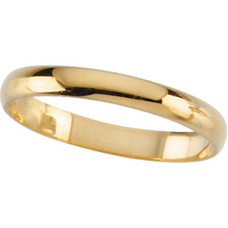
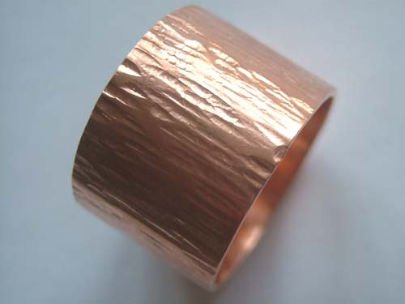
Physical Properties - Examples
Other physical properties include:
Color
Hardness
Odor
Taste
State of matter
Texture
Luster (shine)
Flexibility
Heat conductivity
Electrical conductivity
Solubility (ability to dissolve in water.)
Shape
Viscosity
Ductility
Malleability

Slide 9
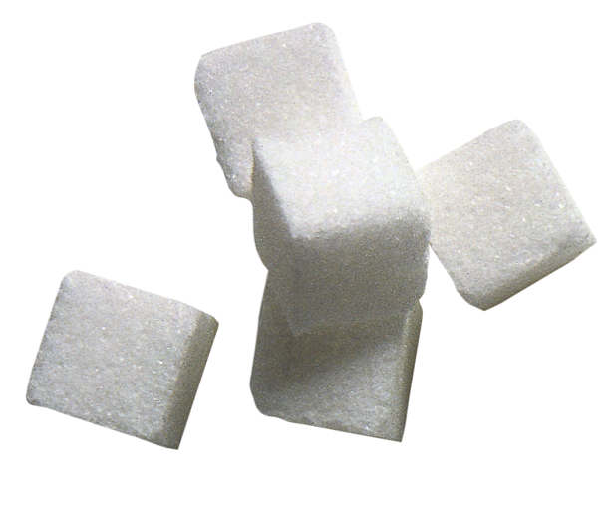
Physical properties
List as many physical properties as you can for this item

Slide 10
Chemical properties
A Chemical property is a characteristic of a substance that can only be observed by changing it into a different substance.

Slide 11
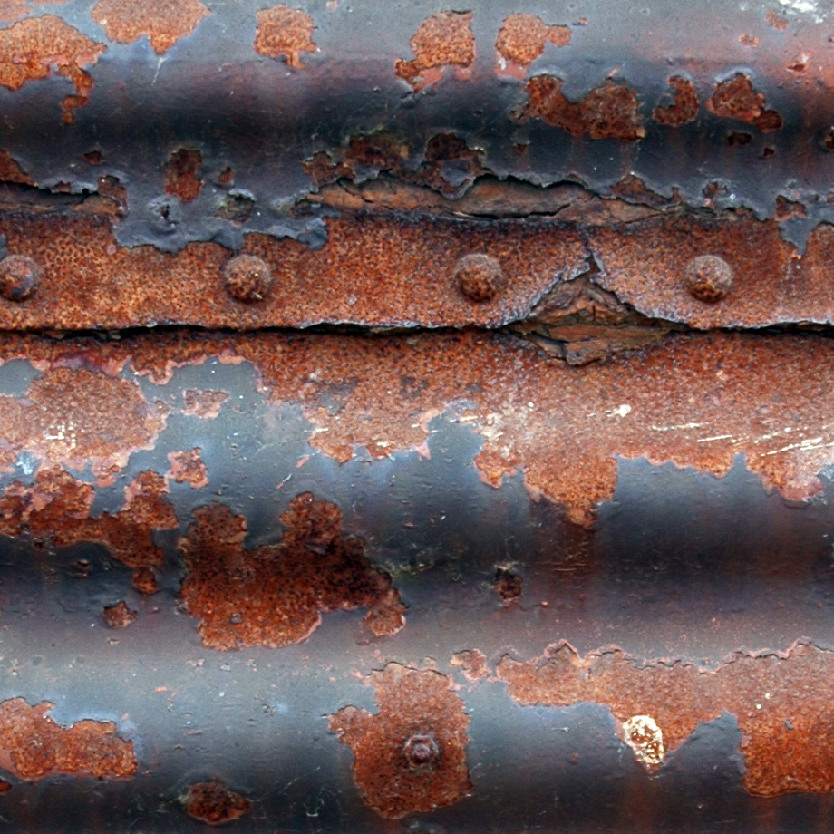
Chemical properties - Examples
Examples of chemical properties include:
The ability to burn
Ability to tarnish
Ability to rust
Ability to decompose
Ability to react with other chemicals
Instability
Ability to do acid/base reactions

Slide 12
Chemical properties
List as many chemical properties as you can for this item.

Slide 13
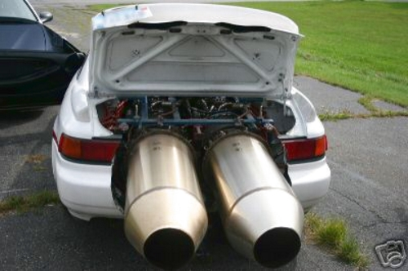
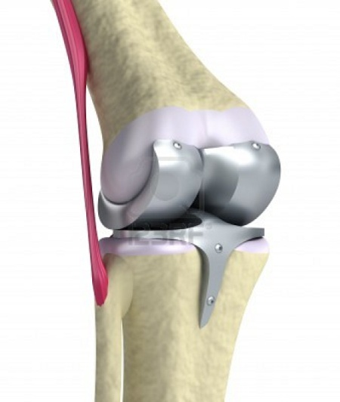
Chemical and physical properties – So what?
Titanium is very strong and doesn’t rust, so it is often used in jet engines.
Titanium is also nonallergenic. This, combined with the fact that it is rust proof makes it great for artificial joints as well as piercings.

Slide 14
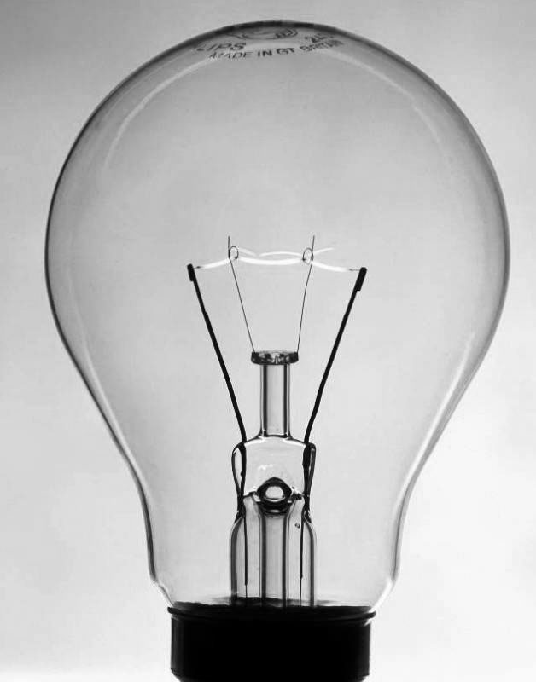
Chemical and physical properties – So what?
Tungsten is usually used as the filament in lightbulbs because it has the highest melting point of any metal.
It glows red hot when electricity runs through it, and it gives off both heat and light.

Slide 15
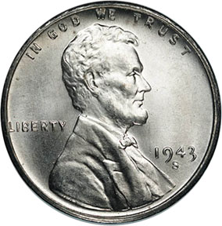
Chemical and physical properties – So what?
In 1943, all US pennies were made of zinc plated steel because copper was being used in the war. The pennies had to be coated with zinc because steel will rust, but zinc won’t.

